Slide 1
Mrs. Carla Schultz
6th Grade Homeroom

Slide 2
Educational Background
1999 Graduate of Bad Axe High School
2004 Graduate of Aquinas College
Bachelor of Arts
Elementary Education Certification
Secondary Math Certification
K-12 Spanish Certification
2008 Graduate of Marygrove College
Masters in the Art of Teaching
2016
Educational Technology Teacher Certification Program

Slide 3
Career History
Entire teaching career has been at St. Paul on the Lake Catholic School!
2005-2014: Spanish Teacher
2014 – Present: 6th Grade Homeroom Teacher

Slide 4
Subjects Taught
6th Grade
6th Grade
7th Grade
6th Grade

Slide 5
The Areas Addressed in 6th Grade Religion
Revelation – How God reveals himself to us in the Bible
Trinity – How God guides and provides for us when we put our faith in him
Jesus Christ – Understand all the leaders in the Bible and all the wisdom that they brought to us.
The Church – Gather an understanding of the history of The Church and the meaning behind the symbolism and actions we perform in mass
Morality – Justice, Peace, the Forgiveness of Sin, and the Ten Commandments
Sacraments – Baptism, Service and sharing God’s Love
Kingdom of God – The Communion of Saints, Christian Unity and the promise of Eternal Life

Slide 6
The Areas Addressed in 6th Grade Math
Write, read, and evaluate expressions in which letters stand for numbers.
Identify parts of an expression or equation using mathematical terms
Use variables to represent numbers and write expressions when solving a real-world or mathematical problem
Interpret and compute quotients of fractions, and solve word problems involving division of fractions by fractions,
Find the greatest common factor, least common multiple, ratios and proportions
Solve mathematical operations using fractions, decimals, integers and rational numbers
Use graphs and tables to interpret data

Slide 7
The Areas Addressed in 6th Grade Science
Design and conduct scientific investigations.
Use tools and equipment appropriate to scientific investigations.
Explain how rocks and fossils are used to understand the age and geological history of the earth.
Explain the different types of rocks and rock cycle.
Explain plate tectonic movement and how the lithospheric plates move centimeters each year.
Explain the states of matter and the changes between them.
Explain the different biospheres, relationships between populations, and the cycles in nature.

Slide 8
The Areas Addressed in 7th Grade Social Studies
All Eastern Hemisphere (Asia, Europe, Africa, and Australia)
Major Units:
Intro to Geography
Southwest & Central Asia (Includes history and origins of three major religions - Judaism, Christianity, and Islam, geography, and current information about countries)
Culture Festival (Choose a country, create a presentation, bring in food)
Map Skills
Current Events

Slide 9
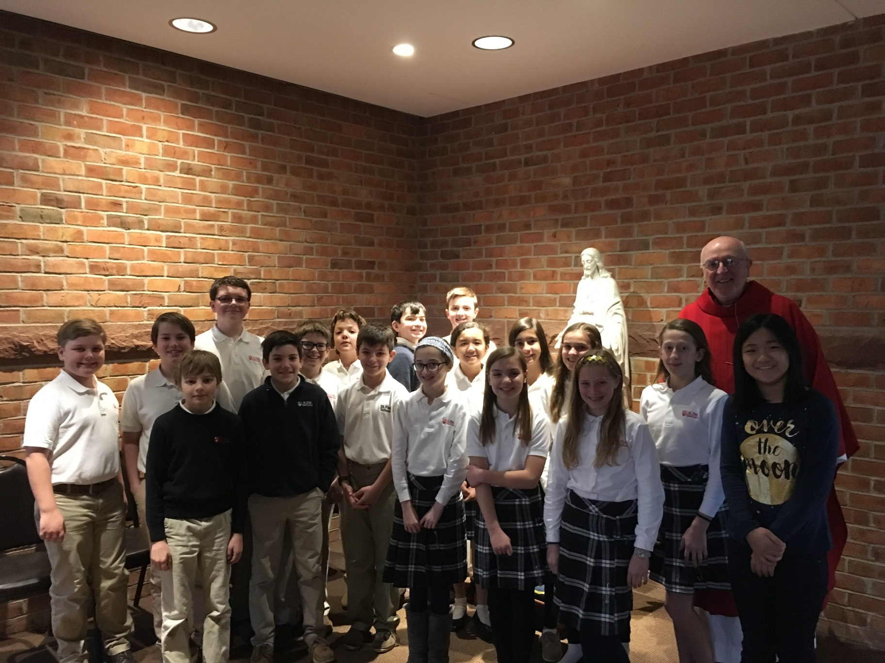
Weekly Mass
Adoration
Praying the Rosary
Retreats
Service Learning
Team Building
Faith Building

Slide 10
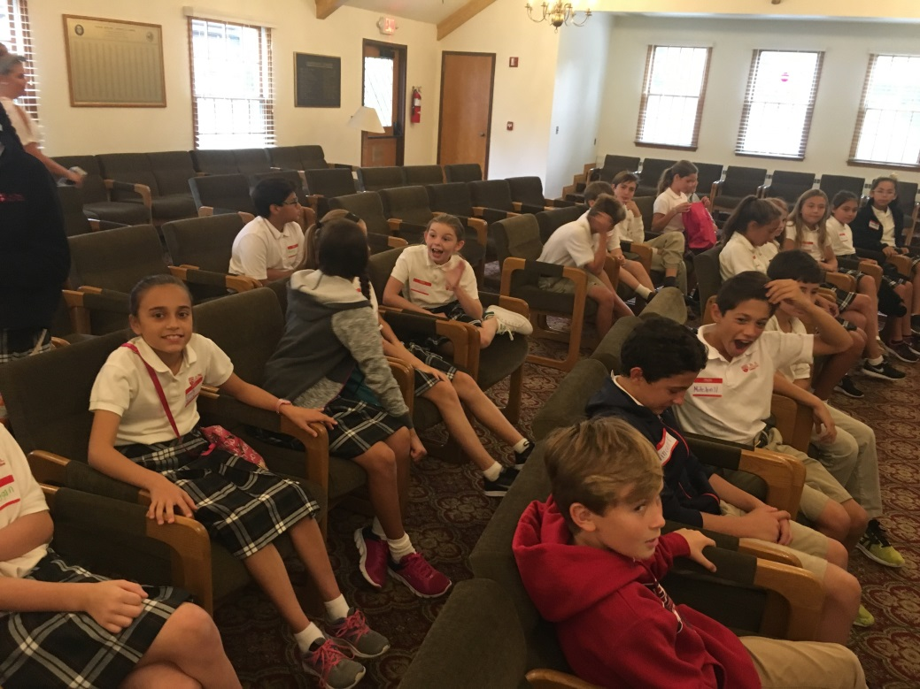
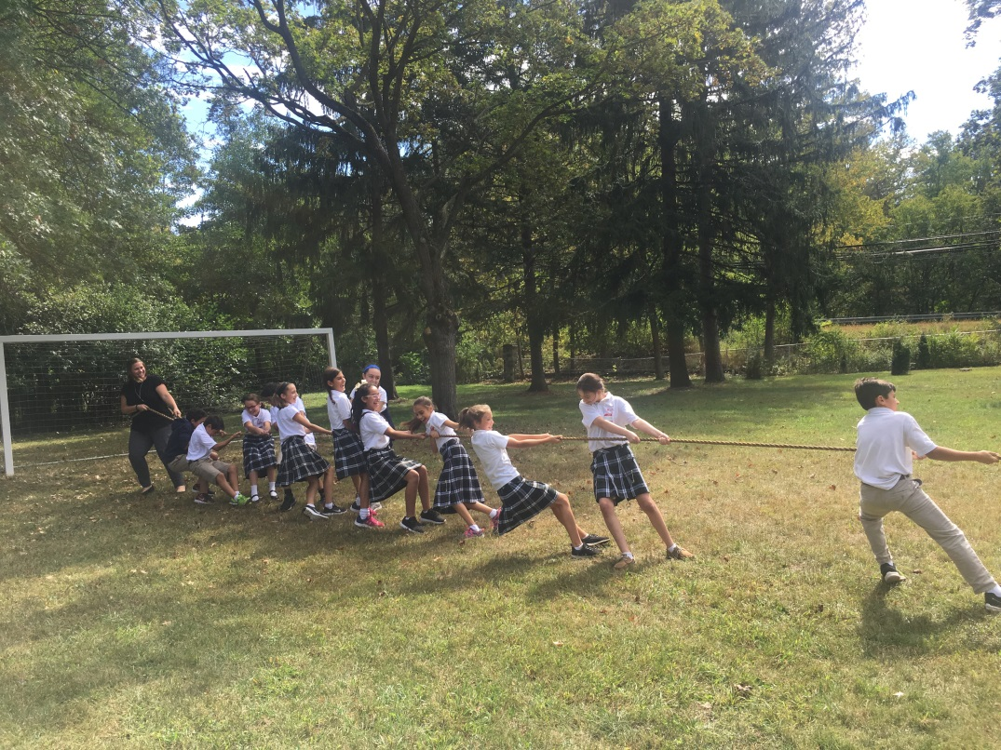
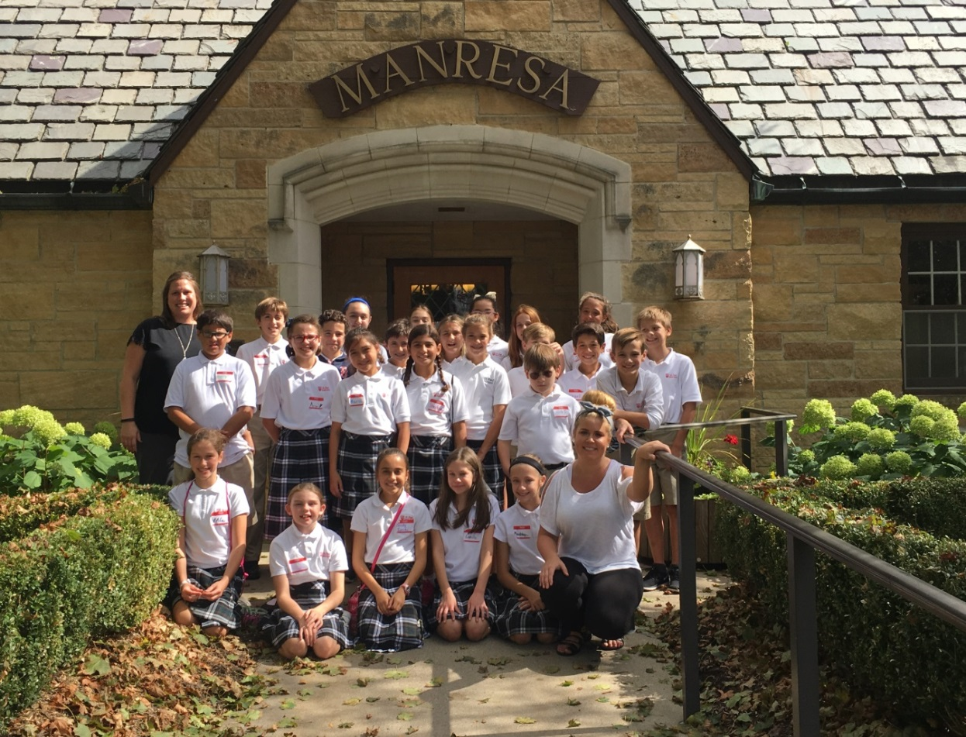
Manresa: A day of retreat, growing in faith and team building

Slide 11
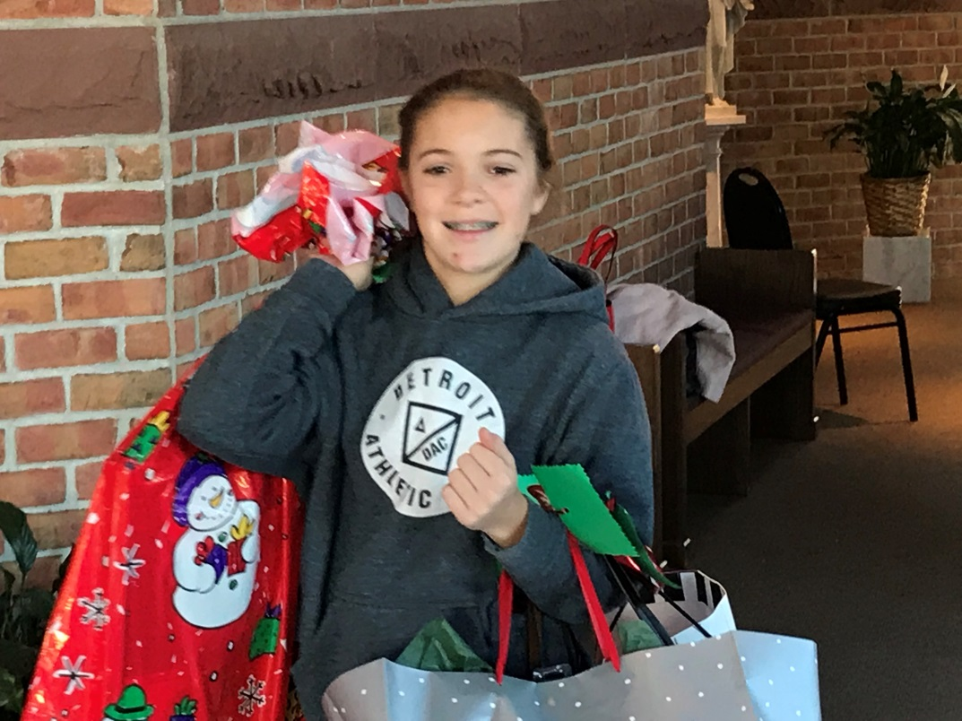
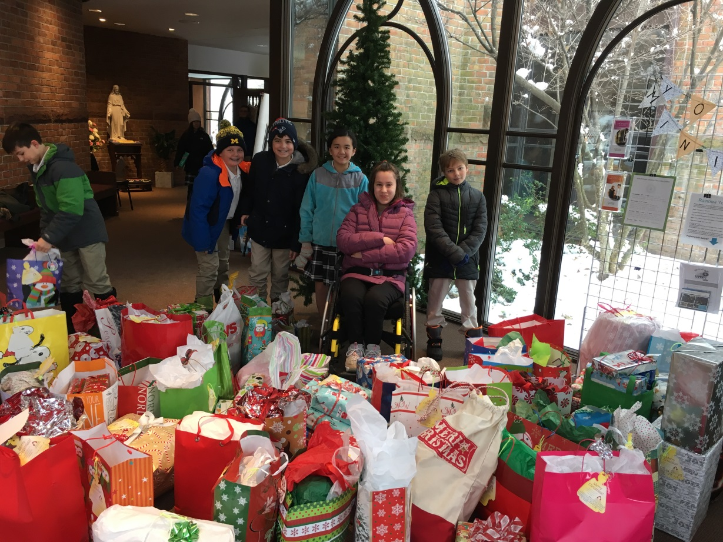
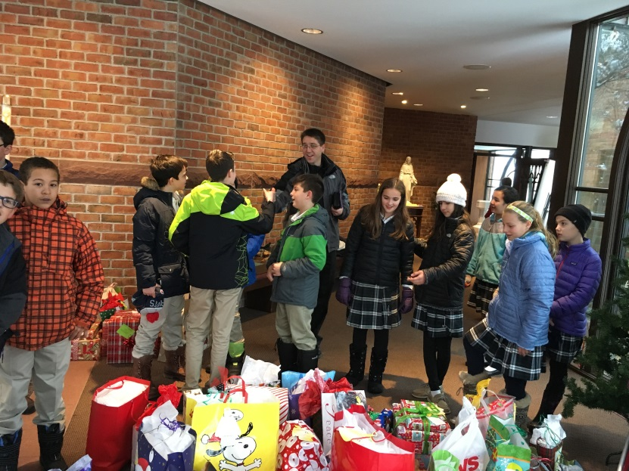
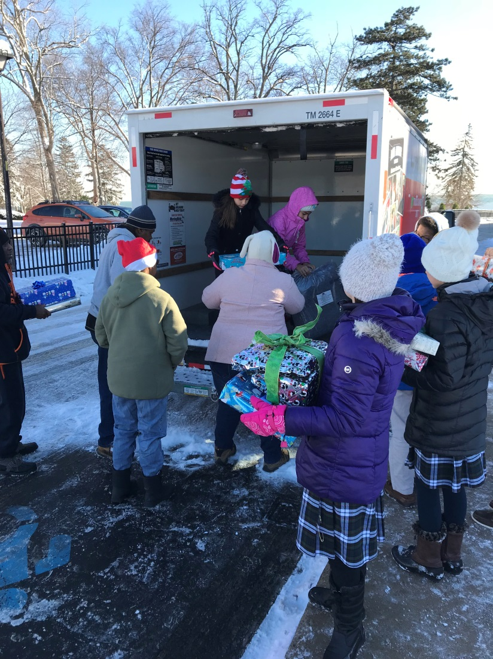
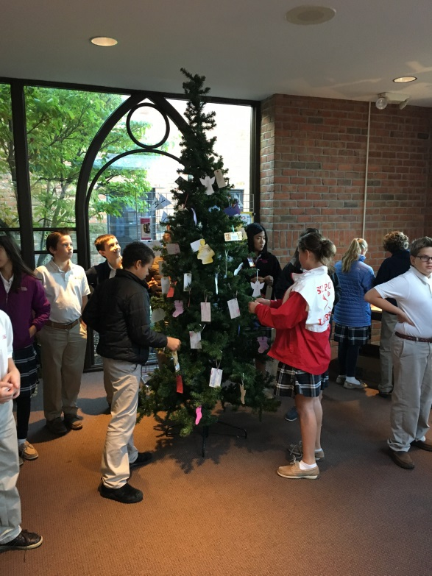
Service

Slide 12
Weekly Newsletter

Slide 13
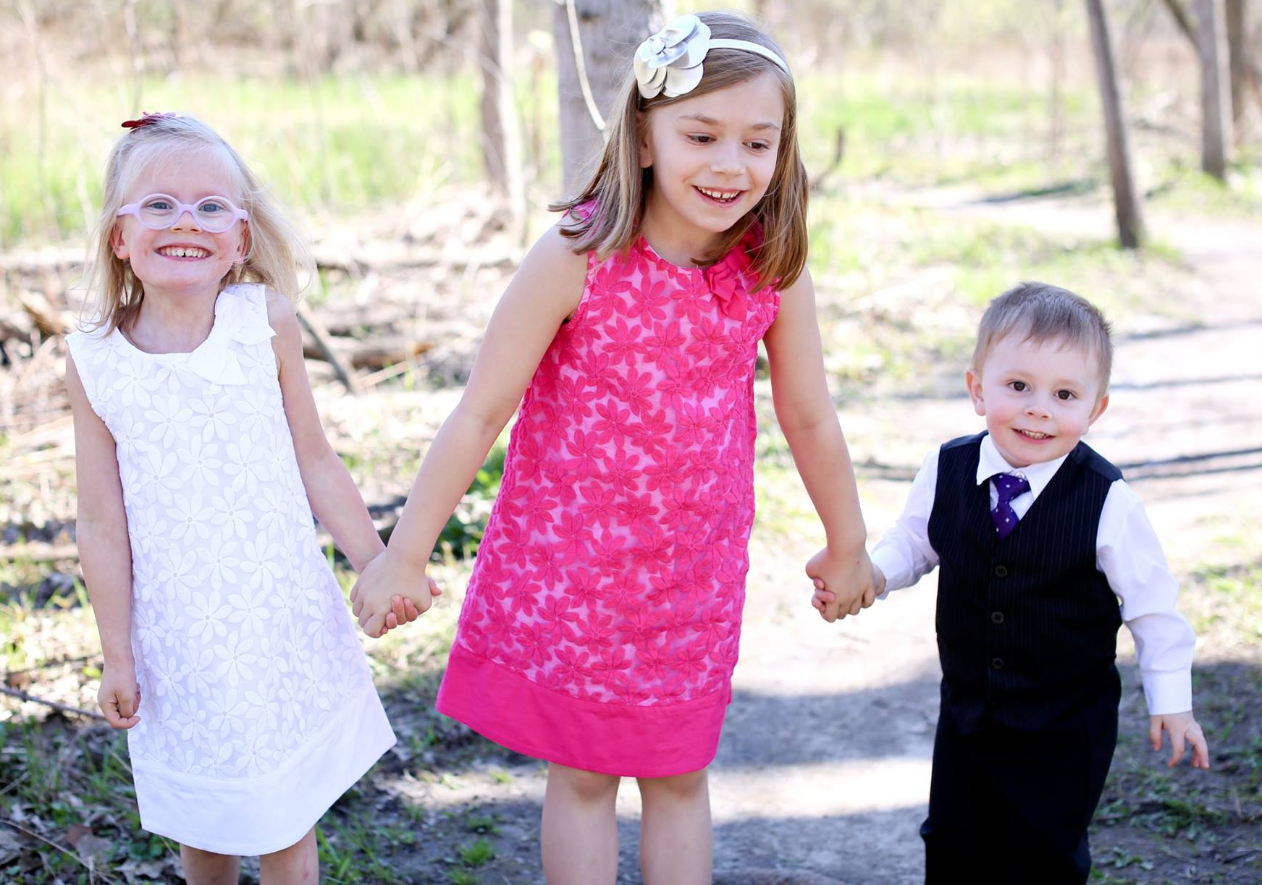
Mrs. Schultz Room 100 cschultz@stpaulonthelake.org http://mrsschultz47.weebly.com

Slide 14
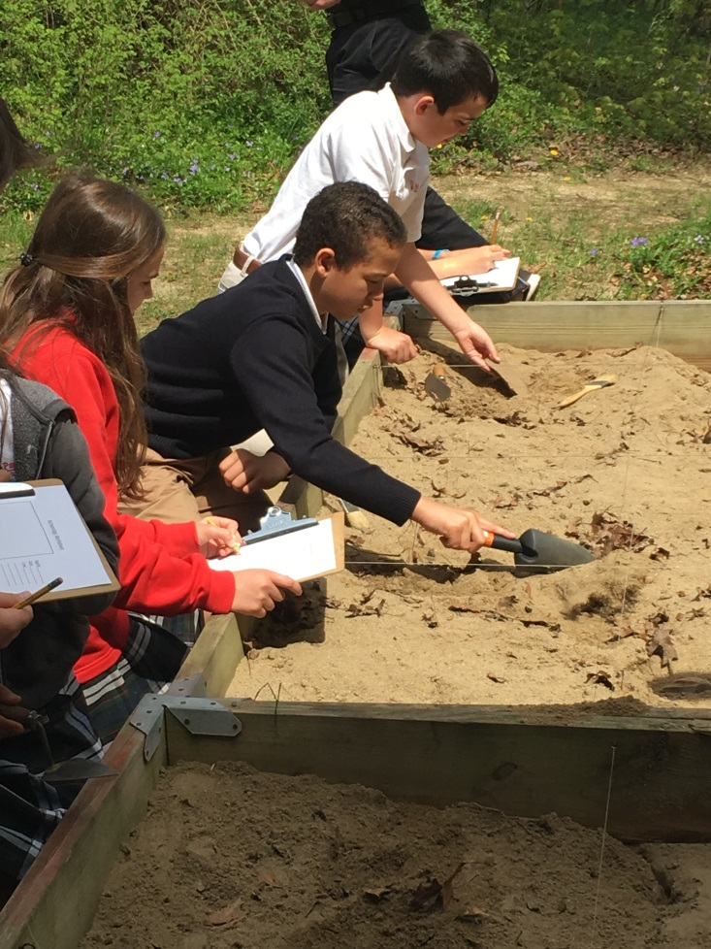
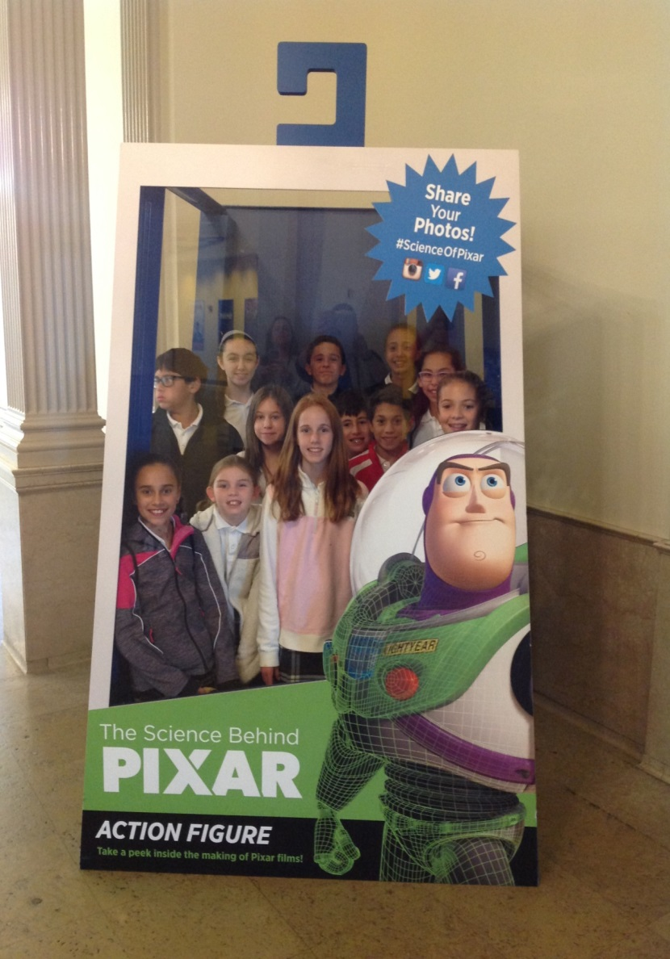
Field Trips

Slide 15
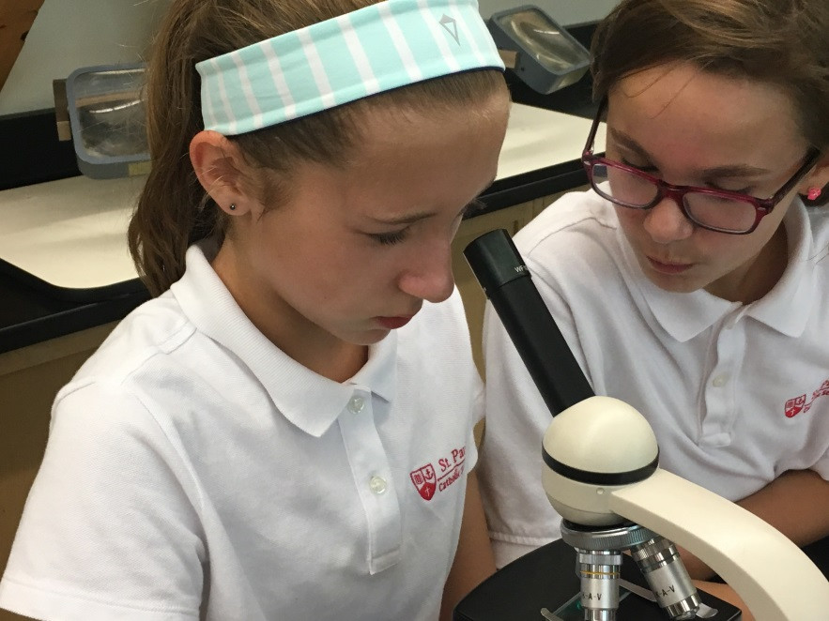
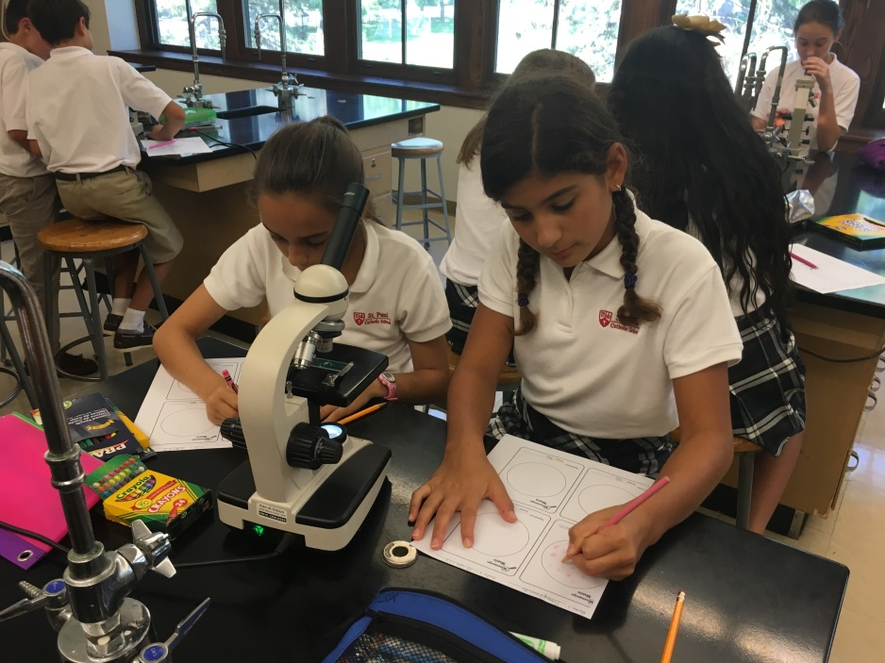
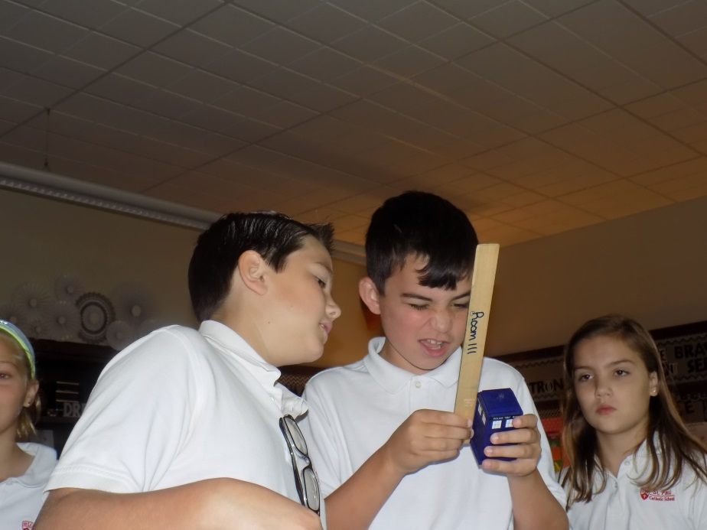
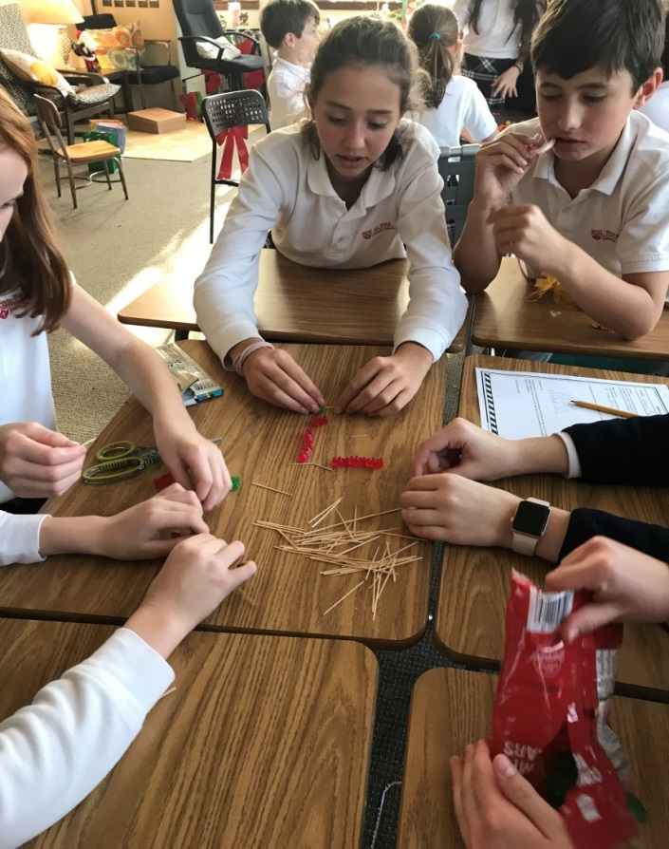
Science and STEM

Slide 16
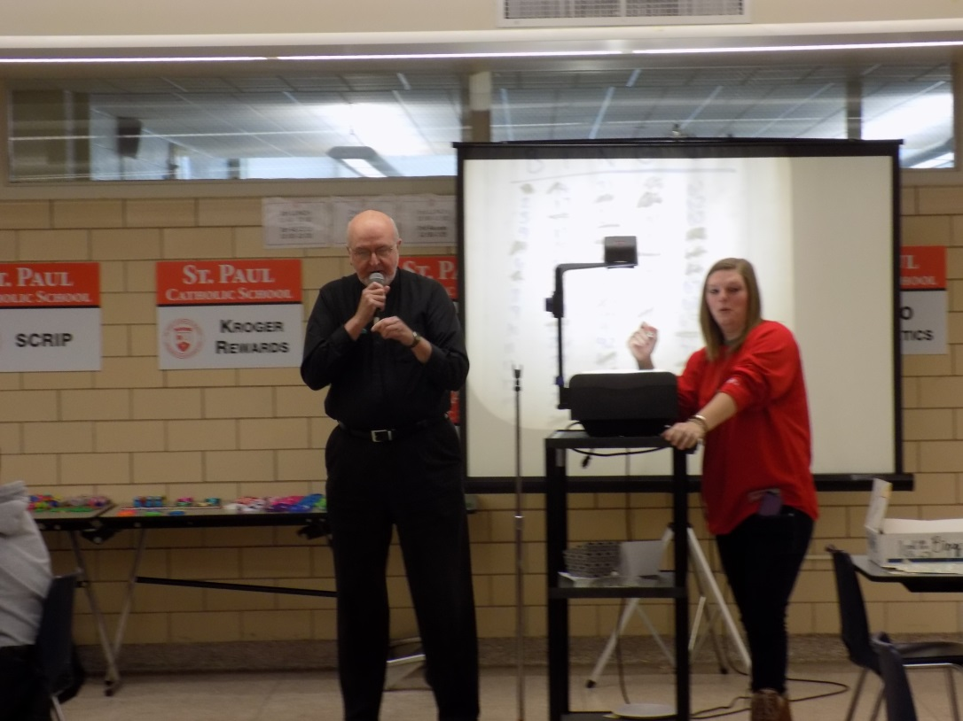
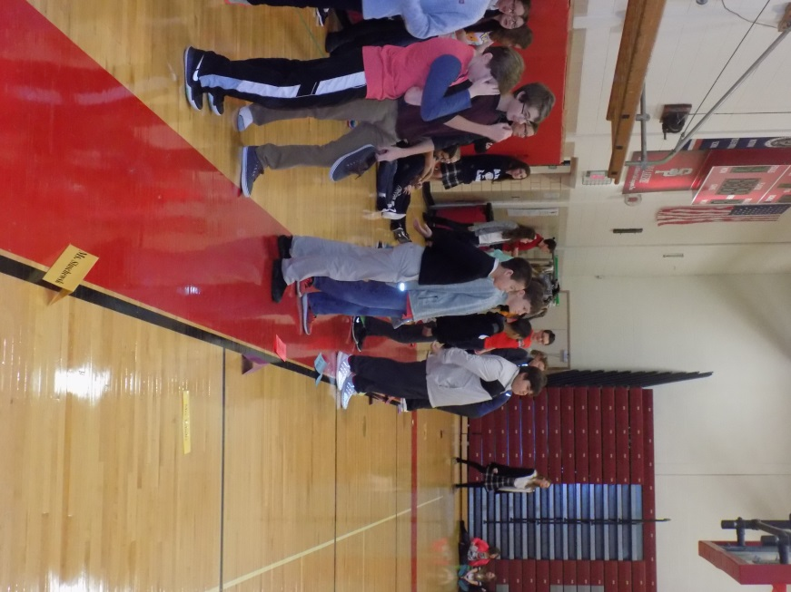
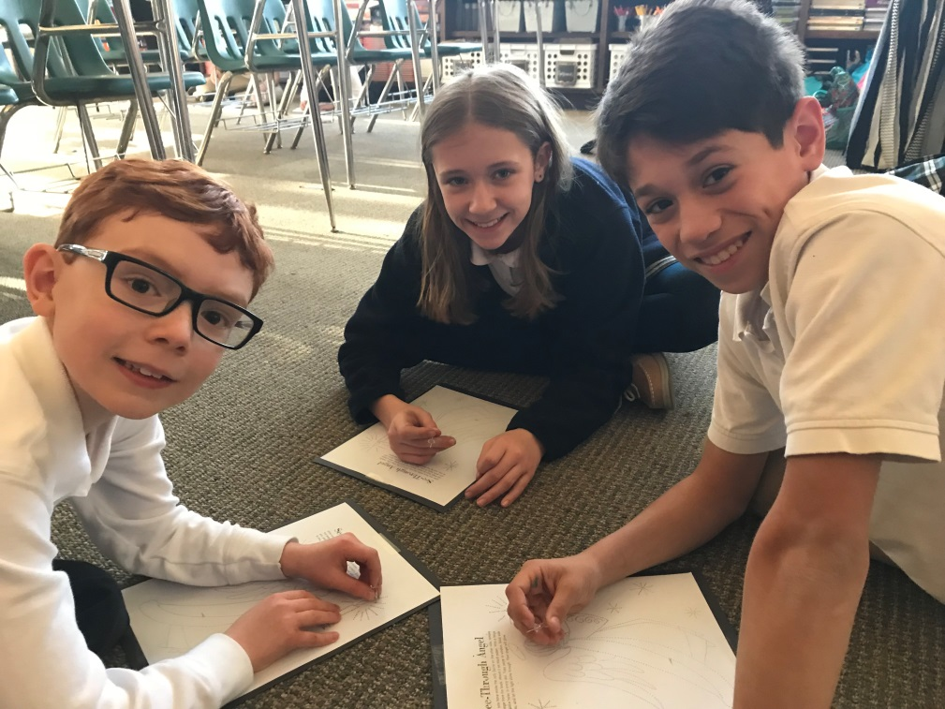
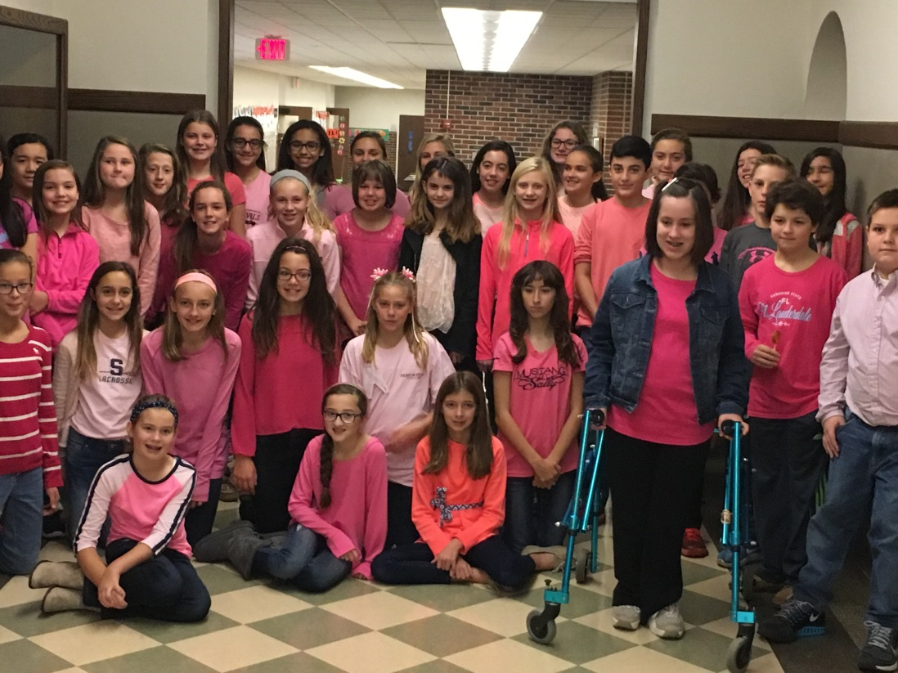
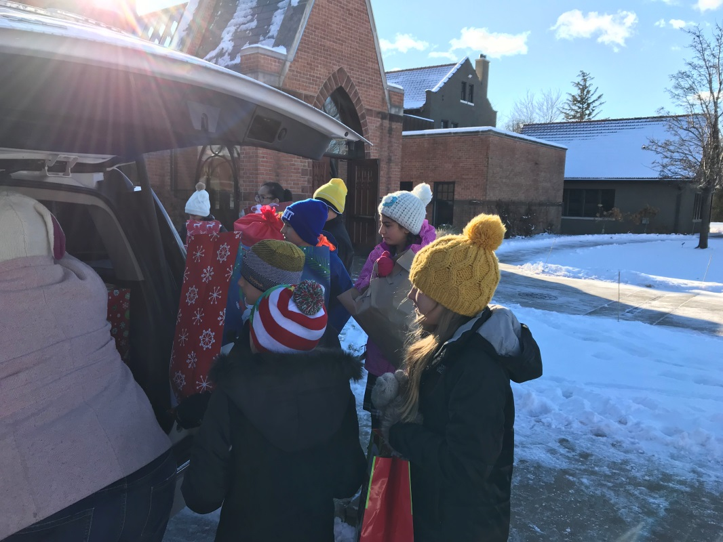
Leadership Council
TAP
ARA
Catholic Schools Week
Buddies

